Slide 1
Dynamic Programming
  Divide & Conquer
    Divide a program instance into independent small instances
    A top-down method
  Dynamic Programming
    Sometimes it’s hard to divide an instance into independent small instances
    Some instances may overlap due to inherent program structure
      A top-down method may introduce redundancies
    Dynamic programming: a bottom-up method
      Build up solution from small subinstances
      Avoid duplicated calculation

Slide 2

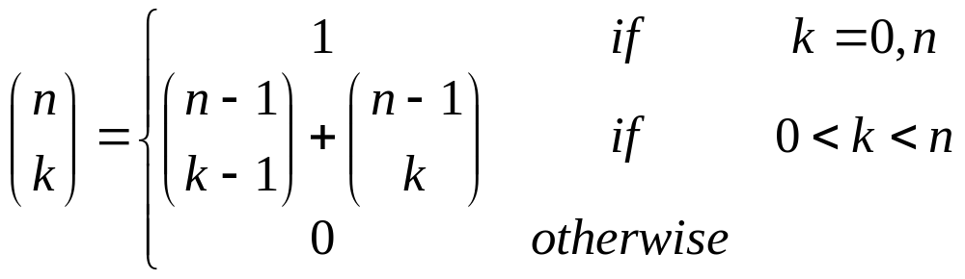
Example: Binomial Coefficient
We want to calculate which can be defined as follows.

Slide 3
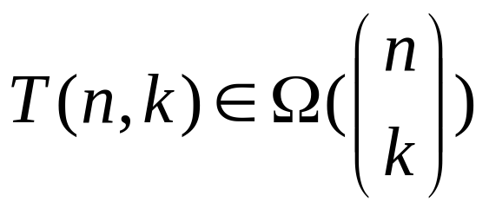
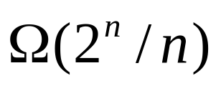
A recursive algorithm
Cost
int C(n,k)
{
if (k==0 || k==n) return 1;
else return C(n-1,k-1)+C(n-1,k);
}
In worst case k=n/2, this is asymptotically

Slide 4
What’s the problem
C(6,3)
1
1
1
C(5,3)
C(5,2)
2
1
C(4,3)
1
C(4,2)
C(4,1)
1
3
3
1
C(3,3)
C(3,2)
C(3,1)
C(3,0)
3
6
3
C(6,3)=20
=#calls to
the leaves
C(2,2)
C(2,1)
C(2,0)
6
6
So many duplicated
calls !
C(1,1)
C(1,0)

Slide 5
A solution using dynamic programming
We instead calculate bottom-up by filling the following table
n k | 0 | 1 | 2 | ……. | k-1 | k
0 | 1
1 | 1 | 1
2 | 1 | 2 | 1
n-1 |  |  |  |  | C(n-1,k-1) | C(n-1,k)
n |  |  |  |  |  | C(n.k)
…
Cost: time Θ(nk) and space Θ(k)

Slide 6
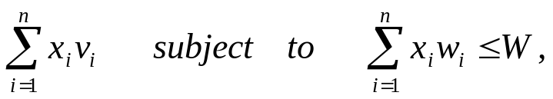
0-1 Knapsack
  n objects 1, 2, ..., n. Object i has weight w_{i} and value v_{i}
  The knapsack can carry a weight not exceeding W.
  Cannot split an object
  Maximize the total value
    Maximize
    where v_{i} , w_{i} > 0 and x_{i}  {0,1} for 1 <= i <= n

Slide 7
The greedy algorithm is no longer optimal
object | 1 | 2 | 3
w_{i} | 6 | 5 | 5
v_{i} | 8 | 5 | 5
W=10

Slide 8
Key to dynamic programming
The principle of optimality
  In an optimal sequence of decisions or choices, each subsequences must be also optimal
0-1 knapsack
  C[i,j] is the maximum value if the weight limit is j and only objects 1 to i are available
  C[i,j] = max(C[i-1,j], C[i-1, j-w_{i}]+v_{i});

Slide 9
Dynamic programming
Set up a table C[0..n, 0..W] with one row for each available object and one column for each weight from 0 to W. Specifically, C[0, j] = 0 for all j.
C[i,j] is the maximum value if the weight limit is j and only objects 1 to i are available
  C[i,j] = max(C[i-1,j], C[i-1, j-w_{i}]+v_{i});
C[n,W] will be the solution

Slide 10
Example
Weight limit | 0 | 1 | 2 | 3 | 4 | 5 | 6 | 7 | 8 | 9 | 10 | 11
w₁ =1 v₁=1 | 0 | 1 | 1 | 1 | 1 | 1 | 1 | 1 | 1 | 1 | 1 | 1
w₂ =2 v₂=6 | 0 | 1 | 6 | 7 | 7 | 7 | 7 | 7 | 7 | 7 | 7 | 7
w₃ =5 v₃=18 | 0 | 1 | 6 | 7 | 7 | 18 | 19 | 24 | 25 | 25 | 25 | 25
w₄ =6 v₄=22 | 0 | 1 | 6 | 7 | 7 | 18 | 22 | 24 | 28 | 29 | 29 | 40
w₅ =7 v₅=28 | 0 | 1 | 6 | 7 | 7 | 18 | 22 | 28 | 29 | 34 | 25 | 40

Slide 11
Algorithm
Knapsack0-1(v, w, n, W)
{
for (w = 0; w<=W; w++) {
c[0,w] = 0;
}
for (i=1; i <=n; i++) {
c[i,0] = 0
for (w=1; w<=W; w++) {
if (w[i] < w) {
if (c[i-1,w-w[i]]+v[i] > c[i-1,w])
c[i,w] = c[i-1,w-w[i]] + v[i];
else c[i,w] = c[i-1,w]
} else c[i,w] = c[i-1,w]
} // for w
} for i
}
The run time performance of this algorithm is Θ(nW)

Slide 12
Finding the objects
i=n;
k=W;
while (i>0 && k>0) {
if (C[i,k] <> C[i-1,k]) {
mark the i-th object as in knapsack;
i = i-1;
k = k-w[i];
} else
i = i-1;
}
Cost: O(n+W)

Slide 13
Example
Weight limit | 0 | 1 | 2 | 3 | 4 | 5 | 6 | 7 | 8 | 9 | 10 | 11
w₁ =1 v₁=1 | 0 | 1 | 1 | 1 | 1 | 1 | 1 | 1 | 1 | 1 | 1 | 1
w₂ =2 v₂=6 | 0 | 1 | 6 | 7 | 7 | 7 | 7 | 7 | 7 | 7 | 7 | 7
w₃ =5 v₃=18 | 0 | 1 | 6 | 7 | 7 | 18 | 19 | 24 | 25 | 25 | 25 | 25
w₄ =6 v₄=22 | 0 | 1 | 6 | 7 | 7 | 18 | 22 | 24 | 28 | 29 | 29 | 40
w₅ =7 v₅=28 | 0 | 1 | 6 | 7 | 7 | 18 | 22 | 28 | 29 | 34 | 25 | 40
=

Slide 14
Example
Weight limit | 0 | 1 | 2 | 3 | 4 | 5 | 6 | 7 | 8 | 9 | 10 | 11
w₁ =1 v₁=1 | 0 | 1 | 1 | 1 | 1 | 1 | 1 | 1 | 1 | 1 | 1 | 1
w₁ =2 v₁=6 | 0 | 1 | 6 | 7 | 7 | 7 | 7 | 7 | 7 | 7 | 7 | 7
w₁ =5 v₁=18 | 0 | 1 | 6 | 7 | 7 | 18 | 19 | 24 | 25 | 25 | 25 | 25
w₁ =6 v₁=22 | 0 | 1 | 6 | 7 | 7 | 18 | 22 | 24 | 28 | 29 | 29 | 40
w₁ =7 v₁=28 | 0 | 1 | 6 | 7 | 7 | 18 | 22 | 28 | 29 | 34 | 25 | 40


Slide 15
Example
Weight limit | 0 | 1 | 2 | 3 | 4 | 5 | 6 | 7 | 8 | 9 | 10 | 11
w₁ =1 v₁=1 | 0 | 1 | 1 | 1 | 1 | 1 | 1 | 1 | 1 | 1 | 1 | 1
w₂ =2 v₂=6 | 0 | 1 | 6 | 7 | 7 | 7 | 7 | 7 | 7 | 7 | 7 | 7
w₃ =5 v₃=18 | 0 | 1 | 6 | 7 | 7 | 18 | 19 | 24 | 25 | 25 | 25 | 25
w₄ =6 v₄=22 | 0 | 1 | 6 | 7 | 7 | 18 | 22 | 24 | 28 | 29 | 29 | 40
w₅ =7 v₅=28 | 0 | 1 | 6 | 7 | 7 | 18 | 22 | 28 | 29 | 34 | 25 | 40


